Slide 1
Zero Trust Strategy
Discussion of Findings

Slide 2
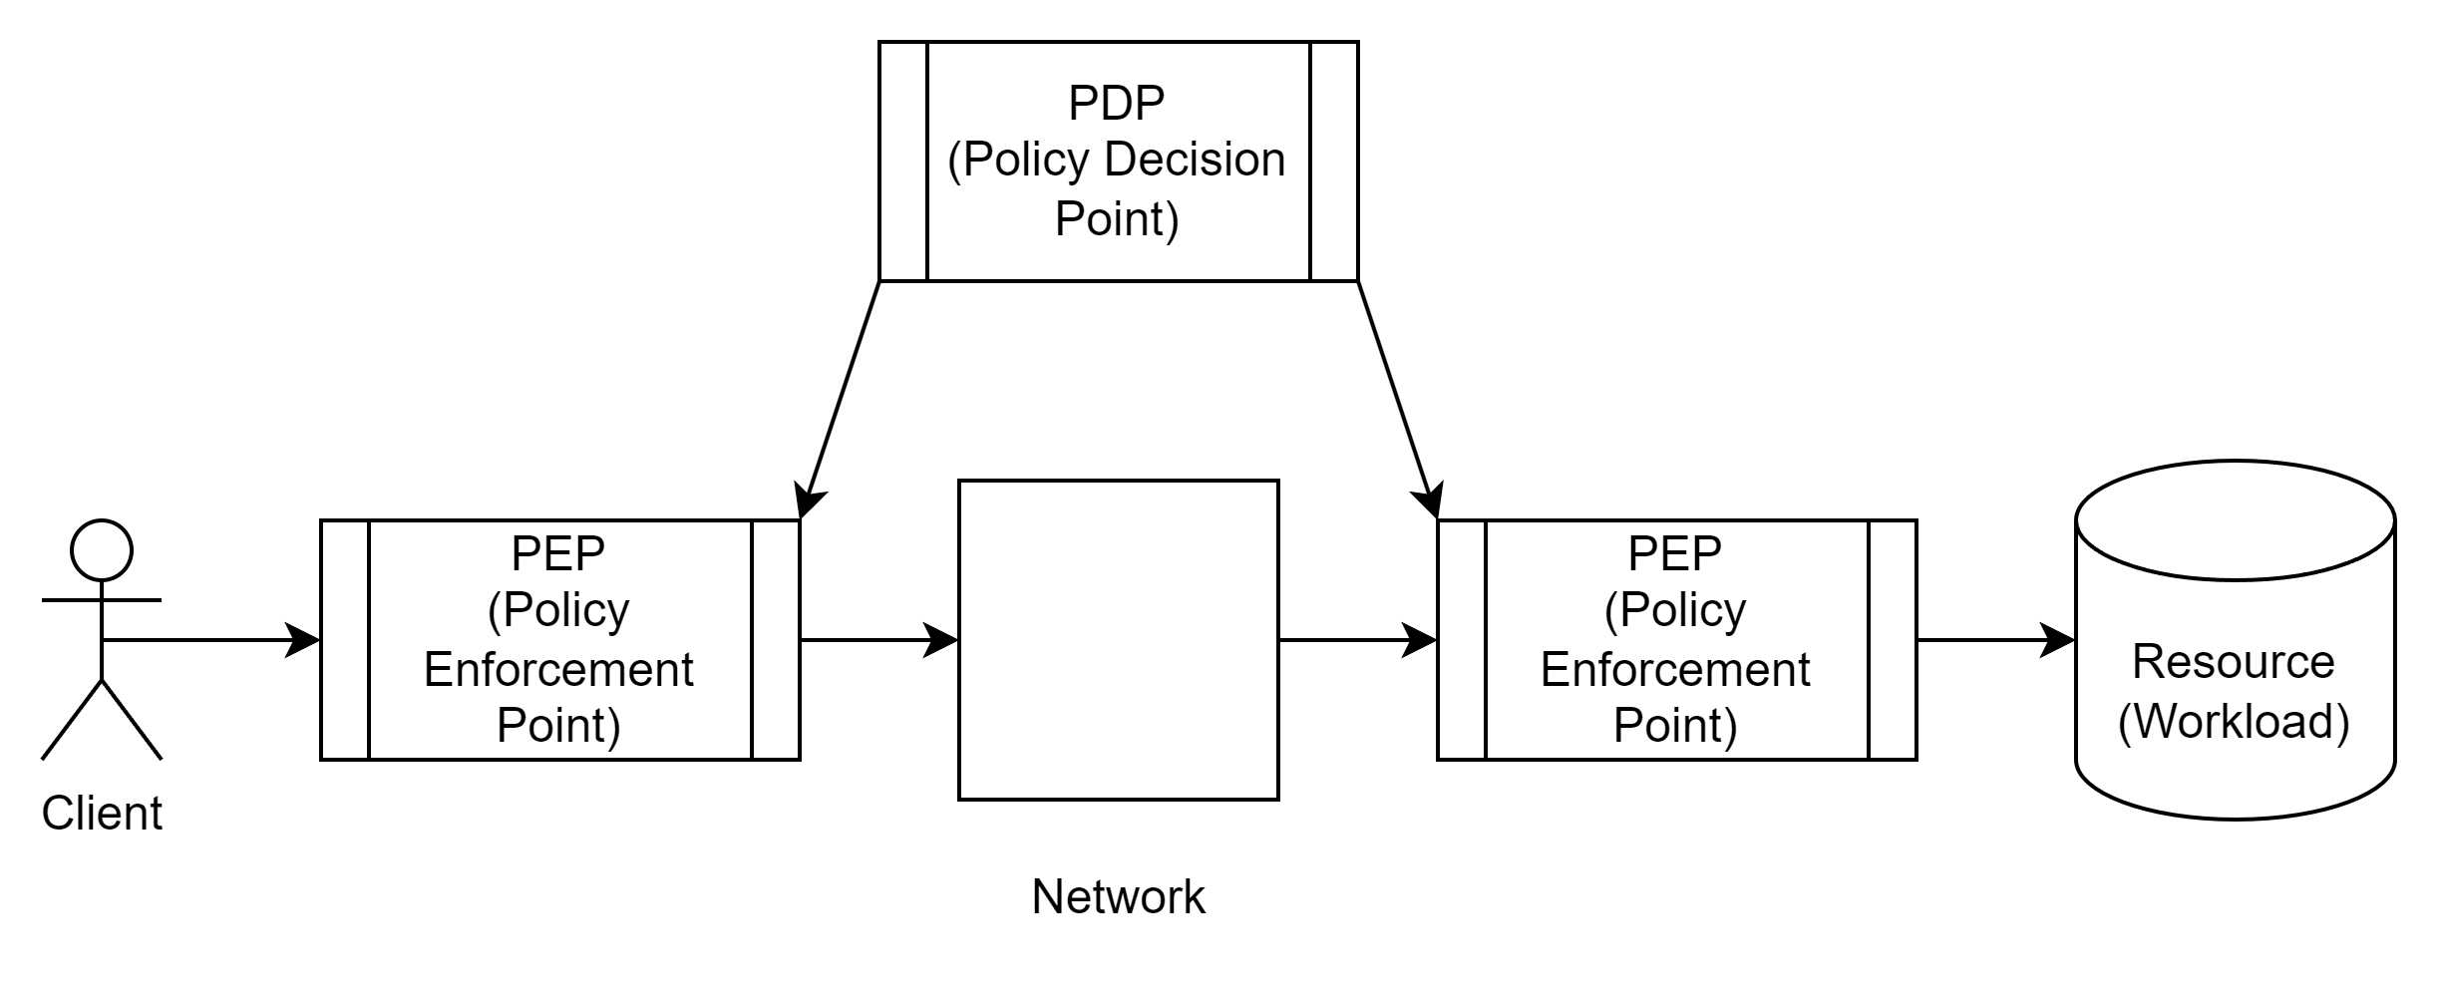
Zero Trust – A Simple Concept

Slide 3
Zero Trust Principles
Ensure all resources are accessed securely, regardless of location.
Adopt a least privilege strategy and strictly enforce access control.
Inspect and log all traffic.
Automate actions across environments and systems, driven by context and events.
Ensure all components support Zero Trust.

Slide 4

Zero Trust in a Nutshell
This video excerpt is used for commentary and educational purposes under the Fair Use doctrine (17 U.S.C. § 107).

Slide 5
Analyzing the ‘Get Smart’ Clip in a Zero Trust Context
Maxell Smart walks in from the street. There is no security check in.
The CONTROL building is a highly secure, compartmentalized building. Agents are allowed only to specific area based on need.
A highly monitored redline ‘network’ leads people to destinations.
Security barriers open and close automatically.
Manual activity is only required when Smart needs specific access to an undisclosed area through the phonebooth lift.
SPECULATION: What would happen if at any point the system decided that Maxwell Smart was an impostor or bad actor?

Slide 6
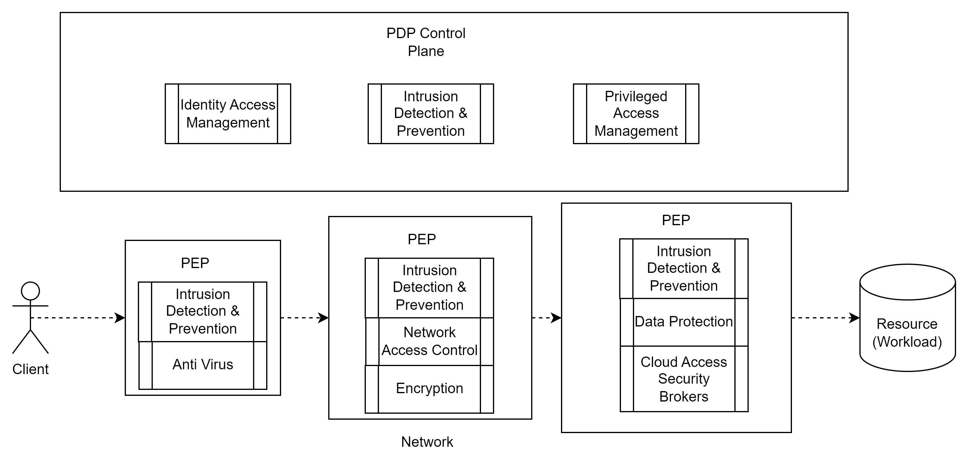
Zero Trust Architecture

Slide 7
Topics Covered in White Paper
Identity and Access Management
Privileged Access Management
Network Infrastructure
Intrusion Detection and Prevention Systems
Data Protection
Infrastructure and Platform as a Service
Secure Web Gateways

Slide 8
Recommendations
Develop and articulate a comprehensive Zero Trust strategy.
Illustrate the role of existing security tools/projects in that strategy.
The department and appropriate business users need to receive Zero Trust training explaining concepts and execution.
Create a 24-month Zero Trust road map/plan
  The plan drives the tools, the tools don’t drive the plan.
  Multiple efforts must go on at once, perfect should not be the enemy of good.
  Legacy systems should be siloed, segregated and proxied.
  You can’t be partially dead, pregnant or Zero Trust
A simple, reasonable ‘scorecard’ methodology should be developed to score existing and new systems. Scoring should take place as part of the ARB not an ancillary security review. One stop shop.

